Slide 1
Depression Detection:
Using AI/ML

Slide 2
Prathamesh Mahamuni ITA627
Shudhanshu Prasad ITA649
Prajakta Pawar ITA647
Atharva More ITA635
Presented By:
Group ID:
Guided By:
Prof. Diksha Kale

Slide 3
Contents of this template
1 | INTRODUCTION
2 | OBJECTIVES
3 | LITERATURE SURVEY
4 | EXISTING SYSTEM
5 | PROPOSED SYSTEM
6 | ALGORITHM
7 | IMPLEMENTATION
8 | FUTURE SCOPE
9 | LIMITATIONS

Slide 4
Introduction
Why We Need the Project?
Catch Problems Early: We want to spot when people are feeling really sad as soon as possible so we can help them feel better sooner.
Be Fair and Clear: We're using computers to make sure we're being really fair and clear about how we tell if someone is feeling sad or not.
Help Everyone Easily: We're making a super easy way for anyone to get help when they're feeling down, especially if they're too scared to talk to someone in person.
No Need to Worry: You don't have to worry about people judging you or knowing it's you who's feeling down. Everything is private and anonymous.
Purpose of the Project:
Find Sadness Quickly: We want to make sure we can find out if someone is feeling sad as soon as possible, so we can help them feel better.
Use Computers to Help: We're using computers to make it easier to tell if someone is feeling sad, so we can help them out faster.
Make it Easy for You: We're making a really simple way for you to get help if you're feeling down. You can do it from your phone or computer, and it's really easy to use.
Make Things Better: Our goal is to make sure everyone can get help when they need it and feel better soon.

Slide 5
Objectives
User Interaction:
Design interactive prompts for emotional disclosure.
Create a user-friendly web interface.
Evaluation and Validation:
Evaluate system performance with diverse datasets.
Compare against benchmarks for accuracy.
Usability Testing:
Conduct usability testing for interface refinement.
Incorporate user feedback iteratively.
Impact Assessment:
Measure system impact on depression incidence.
Assess user satisfaction and effectiveness.
Algorithm Development:
Develop CNN algorithms for facial expression analysis.
Implement NLP techniques for sentiment analysis.
Feature Extraction:
Extract facial features indicating emotions.
Analyze textual content for sentiment.
Depression Detection Framework:
Integrate facial and sentiment analysis for depression detection.
Flag prolonged sadness and negative sentiment.

Slide 6
Literature review
Title | Authors | Limitations | Algorithm | Paper description | Future scope | Datasets
Paper #1 Emotion Recognition & Depression Detection using Deep Learning. Vol-9 Issue-3 2023 | Amey Chede, Dyaneshwar Jagadale, Saurabh Dayma, Dr.S.R. Ganorkar. | Accuracy limitations in emotion recognition, Scope restrictions on recognized emotions, Limited effectiveness of chatbot interactions, Resource-intensive processing requirements Challenges in model generalization. | Haar Cascade Classifier, Convolutional Neural Network (CNN), Tkinter Library. | The main idea behind this paper is to develop a system for real-time emotion recognition and depression detection using deep learning techniques.. The goal is to analyze facial expressions in a video feed, identify the emotional state of the user, and address potential depression. The system incorporates a chatbot to engage with users and assess their emotional well-being. | Enhanced accuracy through multimodal data fusion. Integration of real-time physiological signals for deeper insight. Adaptation for diverse cultural and demographic contexts. Exploration of explainable AI techniques for transparency and trust. | Training Dataset (Facial Expression Dataset): Utilized the Kaggle dataset for facial expression, containing 28,709 samples with seven different emotions (happy, sad, surprised, fearful, angry, disgusted, and neutral) in grayscale portraits of people with dimensions 48x48 pixels. These images were used to train the Convolutional Neural Network (CNN) model.
Paper #2 Automated Detection of Human Mental Disorder Published in The Journal of Electrical Systems and Information Technology, 2023 | Shereen A. Hussein, Abd El Rahman S. Bayoumi, Ayat M. Soliman. | The study may have limitations regarding the generalization of the model to diverse populations and the reliance solely on facial expressions for mental health prediction. It also raises ethical and privacy concerns related to data security, informed consent, and potential biases in predictive models. | Haar Cascade Classifier, Convolutional Neural Network (CNN), VGG (Visual Geometry Group) model | The paper presents a machine learning model that detects mental disorders through facial expressions, achieving 95% accuracy. It emphasizes the importance of timely intervention for mental health and compares its model's accuracy with others. The study discusses the significance of mental health and presents a system architecture involving preprocessing, face detection, emotion determination, and disorder classification. Experimental results show high accuracy in emotion classification and disorder prediction, highlighting the model's potential for aiding timely intervention for mental health challenges. | The future of automated mental disorder detection research involves refining facial emotion recognition models, integrating multi-modal data sources like voice analysis, and deploying models in real-world settings for early intervention. Personalized monitoring systems can be developed using longitudinal data and tailored interventions for specific mental health needs. | The datasets used in the research are the FER+ dataset and the extended Cohn-Kanade dataset (CK+). The FER+ dataset contains 38,537 grayscale images of faces at a resolution of 48 × 48 pixels, with the aim of categorizing each face into one of seven emotion categories. The extended Cohn-Kanade dataset contains the facial behavior of 123 participants aged 18 to 30 years, with 327 video sequences matching the seven emotions of interest.

Slide 7
Literature review
Title | Authors | Limitations | Algorithm | Paper description | Future scope | Datasets
Paper #3 Depression Detection Using Machine Learning Techniques on Twitter Data. IEEE 26 May 2022 | Kuganeswaran A/L Govindasamy, Naveen Palanichamy | Limited context in Twitter posts, Reliance on self-disclosed information, Difficulty in distinguishing sarcasm and irony, Lack of diversity in dataset representation, Potential biases in machine learning algorithms. | Decision Tree, Linear SVM, Naïve Bayes, Logistic Regression, NB-SVM hybrid model. | The project aims to detect depression by analyzing Twitter data using machine learning algorithms, specifically Naïve Bayes and NBTree. Techniques involve data preprocessing, sentiment analysis, and classification in WEKA, with a 70-30 train-test split. Both algorithms exhibit similar high accuracy levels (92.34% for 1000 tweets, 97.31% for 3000 tweets). | Integration of advanced natural language processing (NLP) techniques. Exploration of longitudinal data analysis for trend identification. Development of personalized intervention strategies based on user profiles. Investigation into incorporating multimodal data sources for enhanced accuracy. Expansion to other social media platforms for broader mental health insights. | Training Dataset (Twitter Data): Consists of 1000 tweets collected via Tweepy, a Python library for accessing the Twitter API. Testing Dataset (Twitter Data): Consists of an additional 3000 tweets These tweets serve as a separate dataset for evaluating the trained machine learning models for sentiment analysis.
Paper #4 Early Depression Detection from Social Network Using Deep Learning Techniques 2022 IEEE Region 10 Symposium (TENSYMP) on 5-7 June 2022 | Faisal Muhammad Shah, Sajib Kumar Saha Joy, Samir Sadek, Farzad Ahmed, Sifat Ahmed, Rimon Shil, Md. Hasanul Kabir. | Limited interpretability of metadata features' influence on classification. Potential biases in word embeddings affecting feature extraction. Complexity of hyperparameter tuning for LSTM architecture. | Bidirectional Long Short Term Memory (BiLSTM), Word Embedding Techniques, GloVe Embedding, Word2Vec Embedding, FastText Embedding, Trainable Embedding. | The main focus of the research is to use deep learning techniques to detect signs of depression early by analyzing what people post on social media, specifically on Reddit. They want to develop a model that can identify depressive language patterns in text posts, which could help intervene and support individuals who may be at risk of depression or suicide. | Integration of attention mechanisms for enhanced feature extraction. Exploration of ensemble learning techniques to improve classification performance. Investigation into domain adaptation methods for transferring model to different datasets. Development of explainable AI techniques to interpret model decisions. Expansion to other social media platforms for broader mental health analysis. | Training (Reddit Data): This dataset consists of 531,453 posts from 892 different users collected from Reddit for the CLEF eRisk 2017 project. The users are divided into depressed and non-depressed classes, with a maximum 2000 posts per user. Testing Dataset (Reddit Data): Similarly, the testing dataset comprises 401 users from the same Reddit dataset used for the CLEF eRisk 2017 project. These users were not included in the training dataset and are used to evaluate the performance of the trained model.

Slide 8
Literature review
Title | Authors | Limitations | Algorithm | Paper description | Future scope | Datasets
Paper #5 Different Approaches in Depression Analysis : A Review 2021 International Conference on Computational Performance Evaluation (ComPE) India. July 2-4, 2021 | Swathy Krishna, Anju J | Deep learning for depression detection encounters challenges in obtaining diverse, high-quality data, interpreting model decisions due to their black-box nature, generalizing to new contexts, and managing computational demands, which can hinder accessibility for researchers and clinicians. | Fisher vector algorithm, LTrP (Local tetra pattern), Active Appearance Model (AAM), SVM for classification, Local Binary Pattern (LBP), Deep Convolutional Neural Networks (D-CNN), ANN (Artificial Neural Network). | The discussion revolves around a research paper on depression detection methods, exploring both unimodal (single-feature) and multimodal (multiple-feature) approaches. It emphasizes the challenges in detecting depression and the significance of analyzing various channels such as facial expressions, speech, and behavioral patterns. The paper discusses the limitations of unimodal approaches and highlights the superiority of multimodal systems, especially those incorporating deep learning. Overall, the goal is to improve the accuracy of depression severity assessment, supporting | Future research in depression detection should focus on enhancing accuracy through multimodal data fusion and real-time physiological signal integration. Expanding analysis to other social media platforms will broaden mental health assessment. Adapting models for diverse cultural contexts and exploring transparent AI techniques are crucial. | BerlinEmotional Database (EmoDB): This dataset contains audio recordings of speech samples with annotated emotions, used for identifying different emotions in human speech for depression detection research. Keio University Japanese Emotional Speech Database (KeioESD): This dataset comprises Japanese emotional speech samples, utilized for emotion detection in speech analysis tasks, including depression detection. Ryerson Audio-Visual Database of Emotional Speech and Song (RAVDESS): This dataset consists of audio-visual recordings of speech and song with annotated emotions, employed for emotion recognition research, including detecting stress and depression through speech analysis.

Slide 9
Literature review
Title | Authors | Limitations | Algorithm | Paper description | Future scope | Datasets
Paper #6 Depression Screening in Humans With AI and Deep Learning Techniques. Published on 28th September 2021 | Mudasir Ahmad Wani, Mohammad A. ELAffendi Kashish Ara Shakil, Ali Shariq Imran , Senior Member, IEEE, and Ahmed A. Abd El-Latif , Senior Member, IEEE | The project's narrow scope and reliance on select social media platforms may introduce biases and limit generalizability. The lack of reported false positive and negative rates raises concerns about reliability, while ethical considerations and limited interpretability require attention for responsible deployment. | Word2Vec Term, Frequency-Inverse Document Frequency (TF-IDF),\ Convolutional Neural Network (CNN), Long Short-Term Memory (LSTM). | The main idea of this paper is to propose an efficient artificial intelligence (AI) and deep learning (DL)-based model for identifying individuals with depression on social media platforms. The model uses hybrid feature-based behavioral-biometric signals captured using Word2Vec and term frequency-inverse document frequency (TF-IDF) models to train a convolutional neural network (CNN) and long-short term memory(LSTM) models.Depressive signals from online social network platforms including Facebook, Twitter, and YouTube. The experiments showed promising results, with the Word2Vec LSTM and Word2Vec (CNN + LSTM) models achieving an accuracy of 99.02% and 99.01%, respectively. | Future research could focus on enhancing AI-driven mental health screening on social media by improving accuracy, generalizability, and ethical considerations. This includes improving model interpretability, understanding temporal dynamics, and collaborating with mental health professionals and platforms to integrate screening tools into support systems for personalized interventions. | Small Noisy Depression Dataset (E1): A dataset from a GitHub repository containing approximately 4,000 tweets expressing depressive moods of Twitter users. Depressive Tweet Content Corpus (E2): A dataset witharound7,000instances of tweets written by the general public on social media, identified as users with depressive disorders by medical experts. SMILE Twitter Emotion Dataset (E3): A dataset used to collect normal (non-depression related) samples,containingcolumns such as user_id, happy, not_relevant, angry, sad, and surprise.

Slide 10
Literature review
Title | Authors | Limitations | Algorithm | Paper description | Future scope | Datasets
Paper #7 Depression detection from social network data using machine learning techniques. Published online 2020 Aug 27. | Md. Rafiqul Islam, Muhammad Ashad Kabir, Ashir Ahmed, Abu Raihan M. Kamal, Hua Wang, and Anwaar Ulhaq | Reliance on LIWC may overlook nuanced linguistic cues. Classifier performance may vary based on dataset size and composition. Lack of real-time data collection limits dynamic insights. Sole focus on linguistic features overlooks other potential indicators. Subjective labeling of depression in the dataset may introduce bias. | Support Vector Machine (SVM) Decision Tree (DT) Ensemble methods k-Nearest Neighbor (kNN) | This study focuses on analyzing Facebook data to detect factors indicative of depression among users. Various machine learning techniques are employed to address challenges such as defining depression, extracting relevant factors from comments, and understanding the relationship between these factors and attitudes toward depression. The research explores linguistic cues in user comments and evaluates the performance of classifiers like Decision Tree in detecting depression. The study underscores the significance of depression detection in mental health monitoring on social networks. | In future work, we plan to use another technique to extract paraphrases from more types of emotional features. Also, we plan to use more dataset to verify our techniques efficiency and effectiveness. We are in agreement with the existing body of literature that suggests that more focused studies in depression analysis are needed. Although LIWC has more than 50 attributes, we took total of 21 attributes for detecting depression of Facebook users, the most significant attributes are found to be from emotional process factor. | PubliclyAvailable Facebook Data: This dataset contains users' comments from bipolar, depression, and anxiety Facebook pages.

Slide 11
Research Gap
Data Limitations: Sometimes, the information we get on social media isn't very clear or accurate.For improving the quality of information and labeling conditions like depression, you could consider using natural language processing (NLP) algorithms.
Performance Variability: Keep an eye on how well your system performs and make sure it works well with all kinds of data. For handling performance variability, you might consider using Adaptive Learning Algorithms and Evolutionary Algorithms.
Feature Overlooking: Instead of only paying attention to how people talk or show their feelings, it's important to consider a broader set of information to understand mental health better. Algorithms like Support Vector Machines (SVM), Random Forests, or Neural Networks can be trained to better understand mental health.
Limited Scope and Effectiveness: We can use a special computer program called an algorithm to teach the system about different emotions. RNNs, LSTMs, Sentiment Analysis will help the system learn and recognize when someone is happy, sad, or feeling other emotions.
Difficulty in Handling Sarcasm and Irony: If someone uses positive words but the context suggests something negative, it could be sarcasm.By teaching the computer these patterns, it can start to understand when people are using sarcasm and irony in text. By using NLP and Sentiment Analysis we can overcome on this.

Slide 12
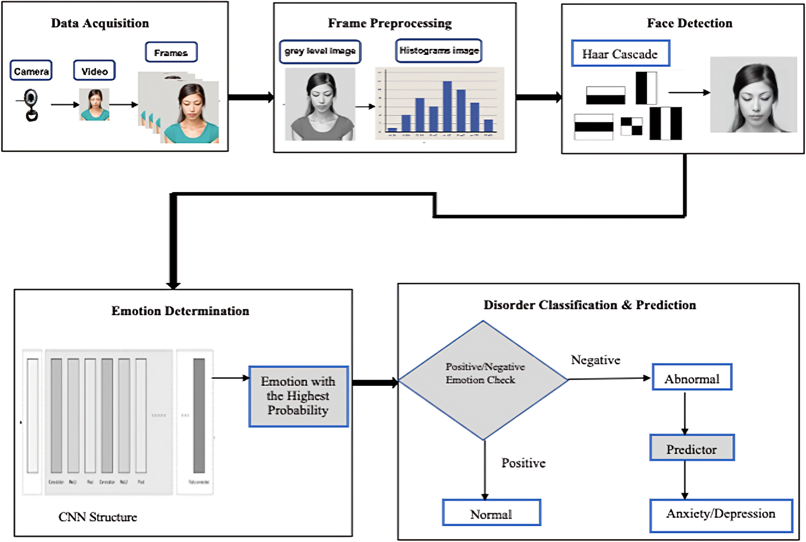
EXISTING SYSTEM

Slide 13
PROPOSED SYSTEM ARCHITECTURE
Datasets
Image
CNN (Convolutional Neural Network) layers, Transfer Learning
Early fusion : Combine modalities' features before classification for analysis.
Classification : Classify individuals into depressed or non-depressed categories by SVM/CNN.
Audio/Voice
MFCCs -> Support Vector Machine (SVM)/Decision Tree, kNN, Ensembling.
Integrate features, using Multimodal fusion techniques
Late fusion : Train separate classifiers per modality, then combine predictions.
Evaluation: Metrics like accuracy, precision, recall, and F1-score on a separate test dataset.
Text
BiLSTM, Term Frequency-Inverse Document Frequency (TF-IDF), Word2Vec, Naïve Bayes / Logistic Regression.
Deployment
CNN, LSTM, Fisher Vector algorithm or Local Binary Pattern (LBP), Deep Convolutional Neural Networks (D-CNN).
Decision-Level Fusion : Combine decisions or scores from individual classifiers.
Video

Slide 14
ALGORITHMS
Text Analysis:
Bidirectional Long Short Term Memory (BiLSTM)
Word Embedding Techniques (GloVe, Word2Vec, FastText)
Convolutional Neural Network (CNN) with text input
Term Frequency-Inverse Document Frequency (TF-IDF) for text feature extraction
Naïve Bayes or Logistic Regression for text classification
Video Analysis:
Convolutional Neural Network (CNN) for video frame analysis
Long Short-Term Memory (LSTM) for sequential video data
Fisher Vector algorithm or Local Binary Pattern (LBP) for feature extraction from video frames
Deep Convolutional Neural Networks (D-CNN) for deeper feature learning from videos

Slide 15
ALGORITHMS
Social Media Posts:
Word Embedding Techniques (GloVe, Word2Vec, FastText)
Convolutional Neural Network (CNN) or Bidirectional Long Short Term Memory (BiLSTM) for social media text analysis
Term Frequency-Inverse Document Frequency (TF-IDF) for feature extraction
Naïve Bayes or Linear SVM for classification
Voice Analysis:
Support Vector Machine (SVM) or Decision Tree (DT) for voice feature classification
Ensemble methods for combining multiple voice features
k-Nearest Neighbor (kNN) for voice similarity detection

Slide 16
IMPLEMENTATION
1. User Interaction:
- Users access the depression detection system through a user-friendly web interface.
2. Data Input:
- Users upload video recordings containing facial expressions and audio content.
3. Data Preprocessing:
- The system preprocesses the video data by extracting facial landmarks and frames for facial expression analysis.
- Audio content from the videos is transcribed to text using speech recognition techniques.
4. Facial Expression Analysis:
- Convolutional Neural Network (CNN) models are employed to recognize facial expressions from the video frames.
- Facial features indicative of emotions such as sadness, fear, and happiness are extracted.
5. Sentiment Analysis:
- Natural Language Processing (NLP) models analyze the transcribed audio content to assess sentiment.
- Textual features are extracted and sentiment is evaluated to identify negative expressions and emotional cues.

Slide 17
IMPLEMENTATION
6. Depression Detection:
- The system integrates facial expression and sentiment analysis modules into a unified depression detection framework.
- Algorithms flag prolonged expressions of sadness and negative sentiment as potential indicators of depression.
7. User Feedback and Engagement:
- Users receive feedback and recommendations based on the analysis results.
- Interactive prompts encourage user engagement and further self-reflection.

Slide 18
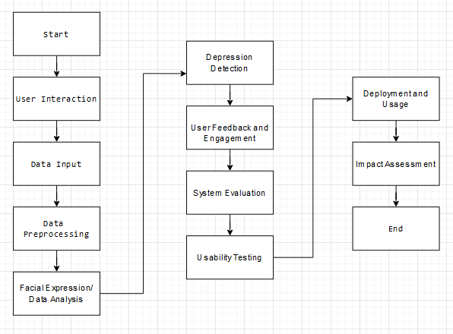
FLOWCHART:

Slide 19
REFERENCES
PAPER 1:Vol-9 Issue-3 2023 IJARIIE-ISSN(O)-2395-4396 EMOTION RECOGNITION AND DEPRESSION DETECTION USING DEEP LEARNING PAPER 2:Automated detection of human mental disorder Shereen A. Hussein* , Abd El Rahman S. Bayoumi and Ayat M. Soliman PAPER 3:2020 IEEE Region 10 Symposium (TENSYMP), 5-7 June 2020, Dhaka, Bangladesh Early Depression Detection from Social Network Using Deep Learning Techniques PAPER4:2020 International Conference on Computational Performance Evaluation (ComPE) North-Eastern Hill University, Shillong, Meghalaya, India. Jul 2-4, 2020 978-1-7281-6644-5/20/$31.00 ©2020 IEEE Different Approaches in Depression Analysis PAPER 5:IEEE TRANSACTIONS ON COMPUTATIONAL SOCIAL SYSTEMS 1 Depression Screening in Humans With AI and Deep Learning Techniques combined datasets. Out of 24 experiments for Word2Vec LSTM | PAPER 6:Depression Screening in Humans With AI and Deep Learning Techniques. Published on 28th September 2021 Mudasir Ahmad Wani, Mohammad A. ELAffendi Kashish Ara Shakil, Ali Shariq Imran , Senior Member, IEEE, and Ahmed A. Abd El-Latif , Senior Member, IEEE PAPER 7:Depression detection from social network data using machine learning techniques. Published online 2020 Aug 27. Md. Rafiqul Islam, Muhammad Ashad Kabir, Ashir Ahmed, Abu Raihan M. Kamal, Hua Wang, and Anwaar Ulhaq

Slide 20
Thanks!
Do you have any questions?

